Slide 1
Quiz Game APPLICATION
PRESENTED BY
ALLA OM SRI AMRUTHA VARSHINI (46289889)
POTTA LAKSHMI RAVALI (46289888)
GORANTLA SARANAYA (46281781)
VANAPALLI BHARGAVI (46282517)
VUDUMULA TEJASWI (46282516)
REPALLE JYOTHI SWARUPA (46294685)

Slide 2

CONTENTS
INTRODUCTION
OBJECTIVE
TECHNOLOGIES REQUIRED
MODULES
FLOW CHART
ER DIAGRAM
WORKING
TOOLS
FEATURES
OUTPUT
CONCLUSION

Slide 3


INTRODUCTION
The project about “Quiz Game Application”. Is a collection of number of different type of questions like technical, general knowledge, sports, etc. A user can access/play 2 rounds of quiz. The first round is called the Warm-up Round. The second is the Challenge round. There are no negative markings.

Slide 4

OBJECTIVE
The objective of this project is very broad in terms of gaining knowledge and sharing knowledge.
To evaluate the knowledge of the participants academics as well as beyond academics.
To measure growth in knowledge, abilities, or skills of the participants.
The Quiz application help to identify what
they know and what they don't know

Slide 5
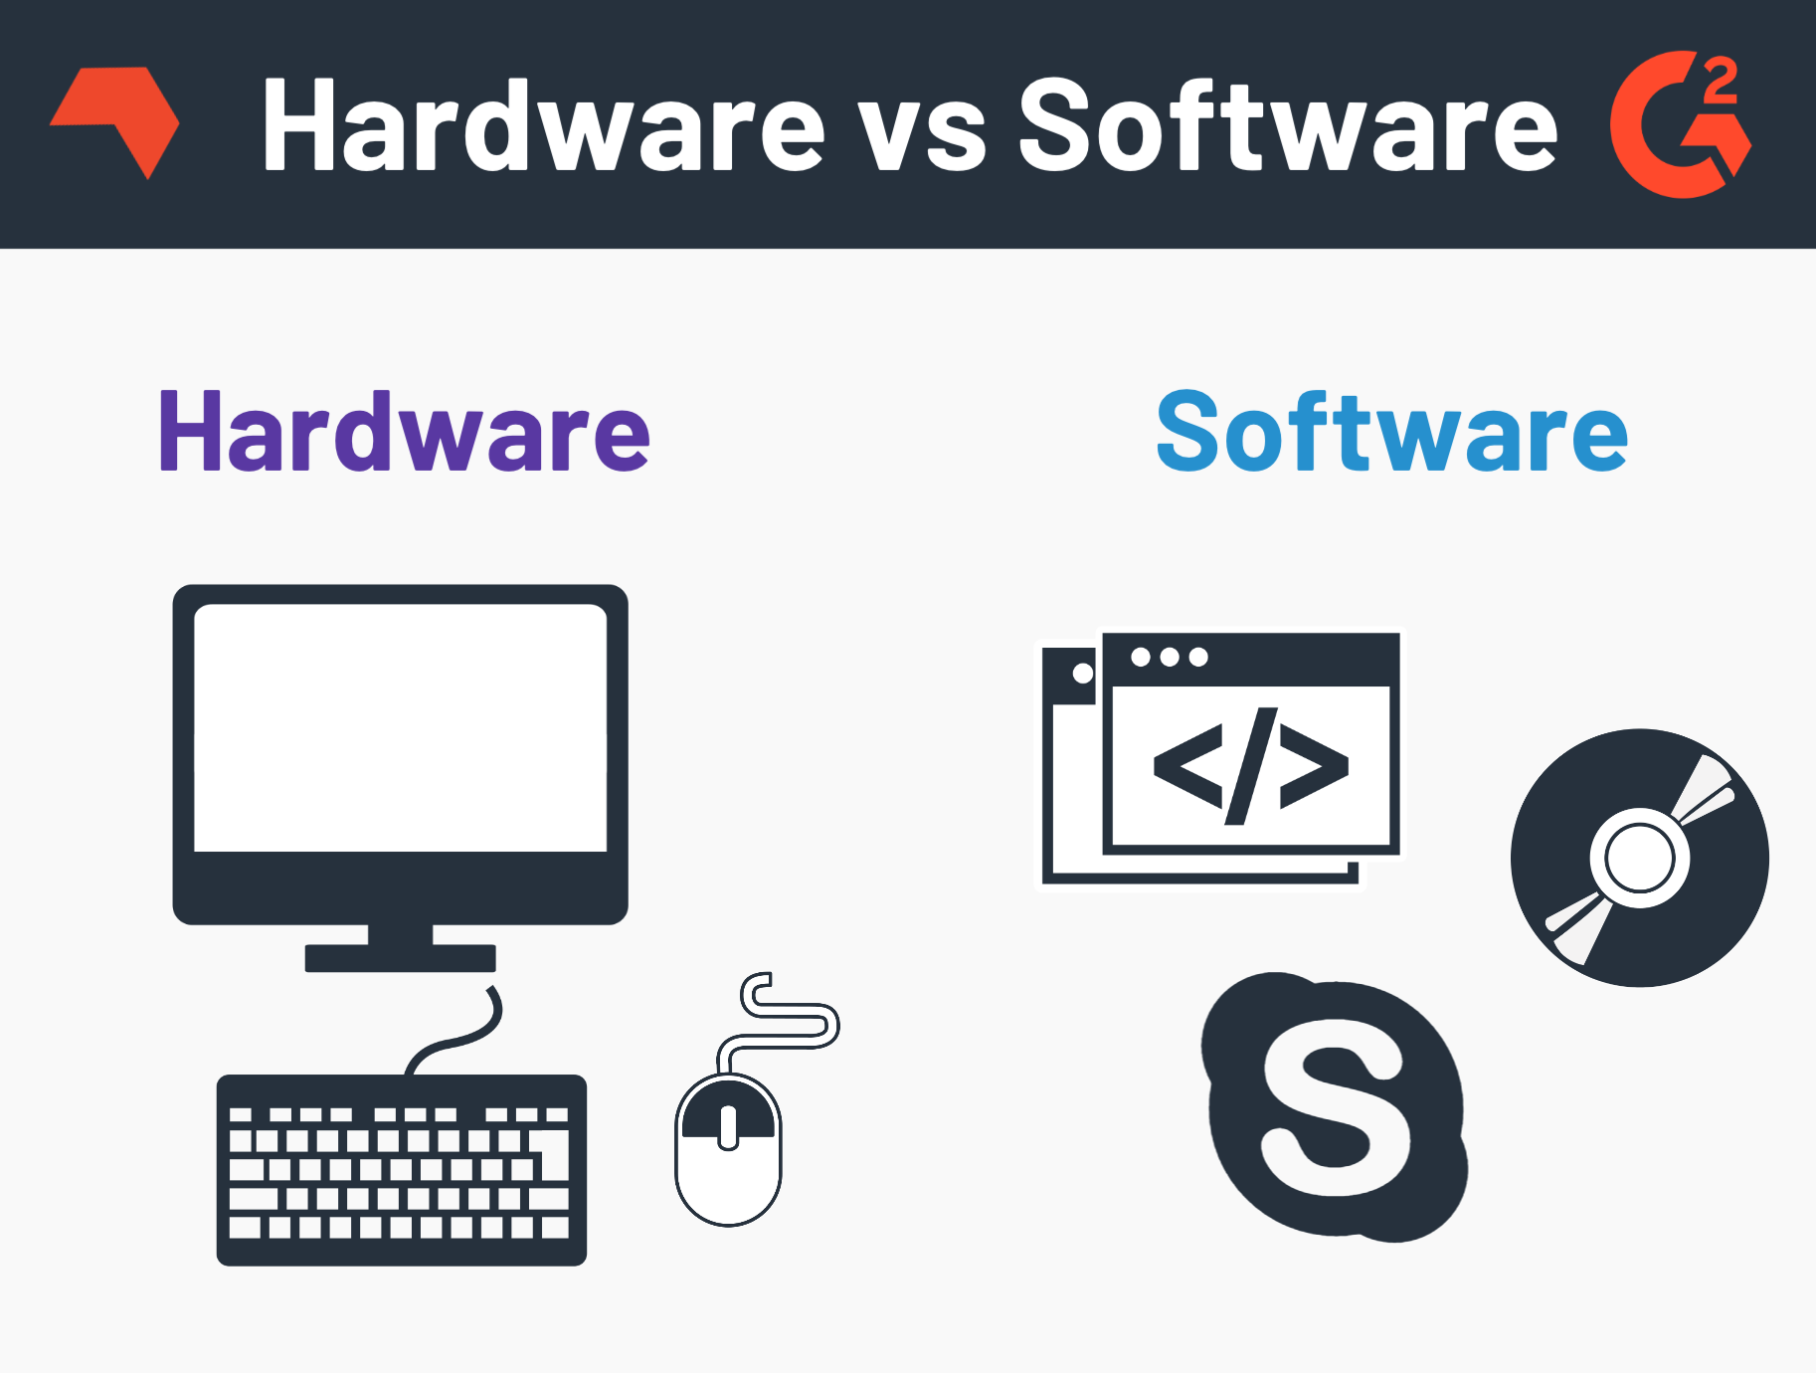
Hardware & software
C language
Ubuntu/Linux terminal​
System with i3 processor.

Slide 6
MODULES
This application has three modules:
Admin:
Admin will always enter details of new coordinator and if any coordinator has left the job, then admin can delete and his/her details must be saved in history.
Coordinator:
Coordinator when creates a new quiz, empty quiz has to be created with unique ID. Later coordinator can add questions and its right answer in the quiz. You must take care that no quiz contains for than 5 questions for round 1 and round 2 contains not more than 10 questions
Contestant:
Contestant after registering/login he/she can play new quiz and can check scoreboard.
.

Slide 7
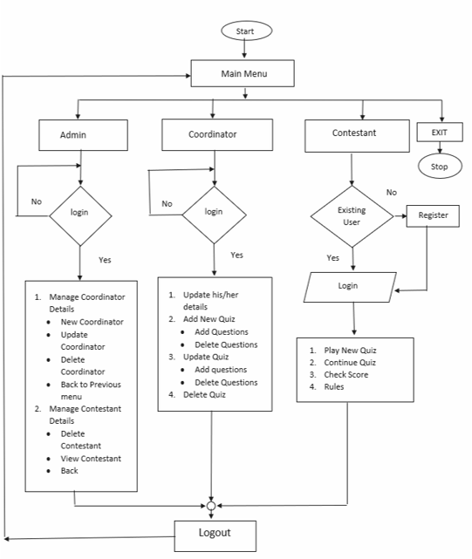
Flow chat

Slide 8
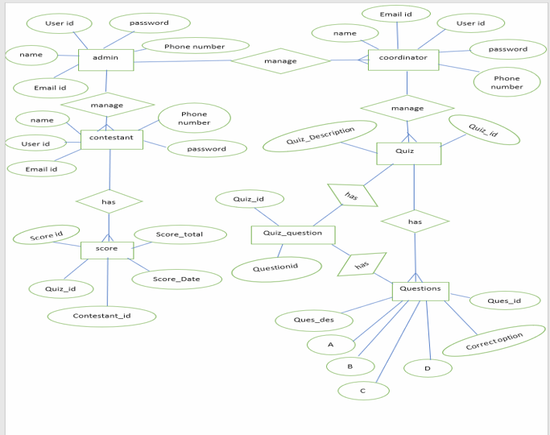
ER diagram

Slide 9
WORKING
Admin:
Manage coordinator details
Manage contestant details
Logout and Exit
Coordinator :
Update his/her details
Add, Update, Delete new quiz
Contestant:
Play new quiz
Continue quiz
Check score
Exit

Slide 10
tools
VALGRIND:
It is memory checking tool to detect memory leaks and it majorly focus on dynamic memory.
SPLINT:
Static analyzer which helps programmer in finding possible errors in program without having to compile or executing the program.
MAKEFILE:
Tool used for run and compile program automatically in more efficient
way.

Slide 11
FEATURES
There are two round in the game.
In 1st round there are 5 questions.
In 2nd round there are 10 questions.
Anyone can play the game.
Easy to access.

Slide 12
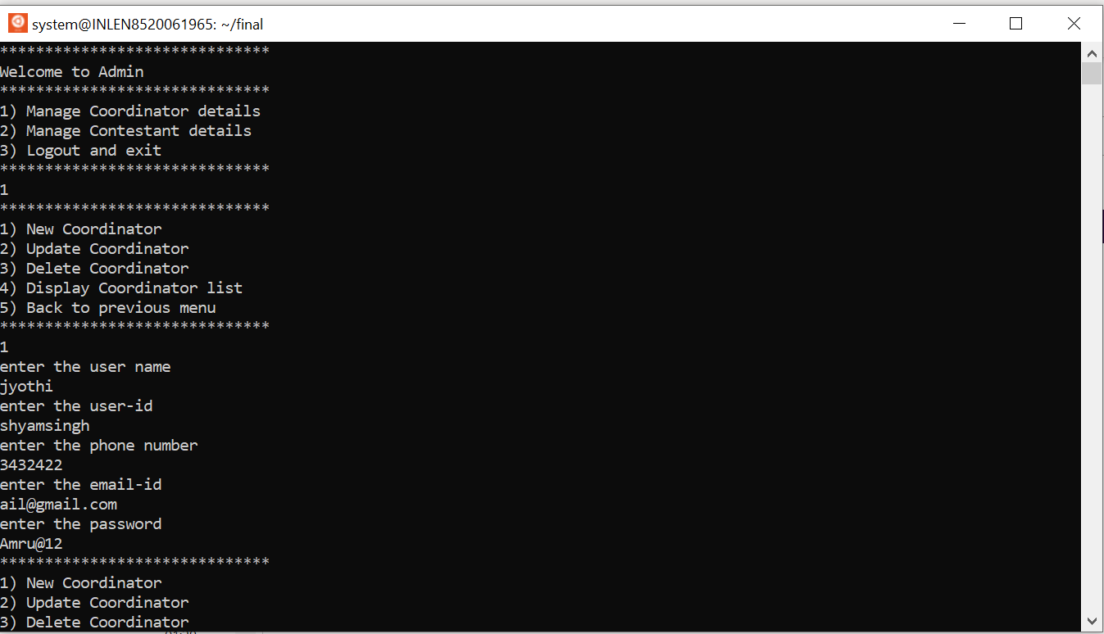
oUTPUT

Slide 13

output

Slide 14
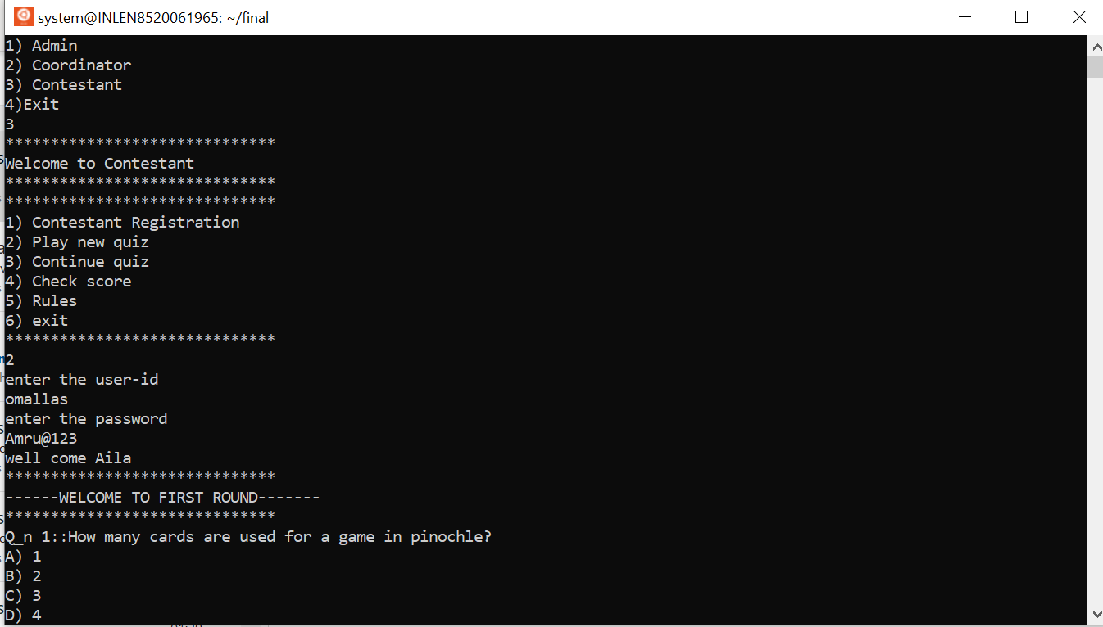
OUTPUT

Slide 15
ADVANTAGES & DISADVANTAGES
ADVANTAGES:
The QGA itself provides authentication & security.
No one can see the user’s credentials that are stored in a separate file.
DISADVANTAGES:
There are also risks associated with the hackers & malicious insiders & careless employees.

Slide 16
CONCLUSION
This project of quiz game application provides facility to play quiz
anywhere and anytime.

Slide 17

THank you
capgemini.com

